Slide 1
PiCar Project: IMU Navigation Algorithm
Sam & Moira

Slide 2
Introduction
The popularity of autonomous driving technology
Accessible & affordable platform: PiCar

Slide 3
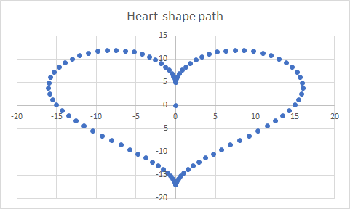
Research proposal
Developing IMU navigation algorithm for driving along a preset path
Building a PiCar
Remote control & self-driving
Data collection & processing using RaspberryPi
Exploring IMU data
Accelerometer
Gyroscope & magnetometer
Developing Self-driving Algorithm
Using IMU data to predict current location
Change steering to drive along preset path

Slide 4
Progress
Built Picar with remote control & self-driving
Wrote Arduino C program for driving
Trimmed remote control inputs
Enabled data transfer between RaspberryPi & Arduino
Wrote python program for communication & data processing
Developed algorithm to calculate location using IMU data
Reliable heading data using magnetometer
Rigid body transformation
Design algorithm to drive along preset path

Slide 5
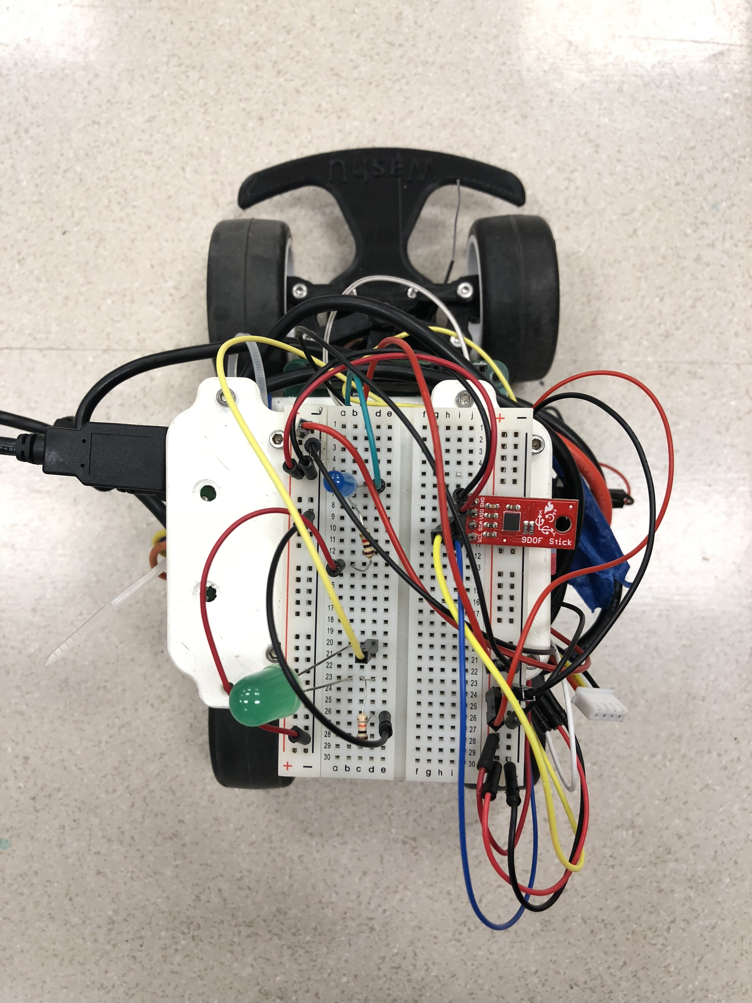
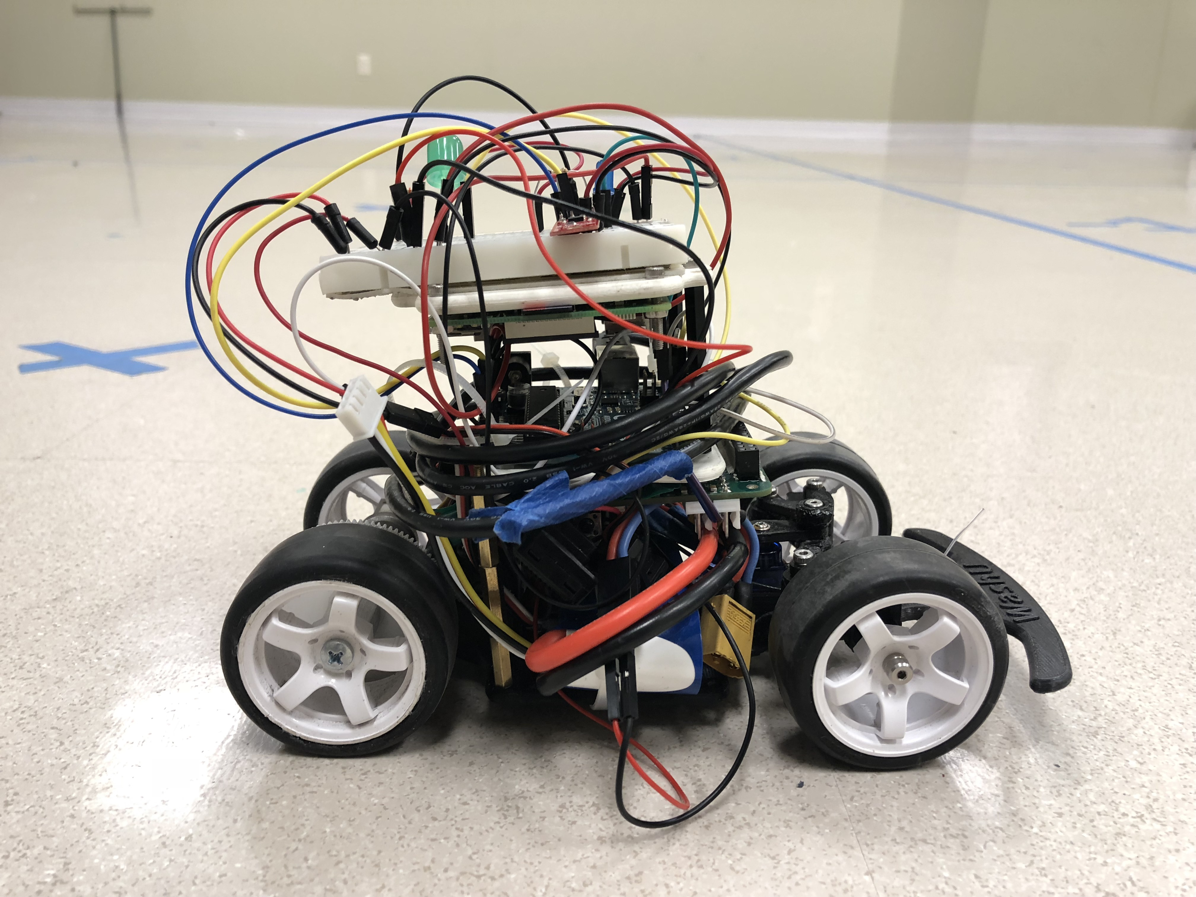
Picar design
RaspberryPi
Arduino
PCB
9 DoF IMU
(LSM9D1)
Motor
LED
Receiver
LiPo Battery

Slide 6
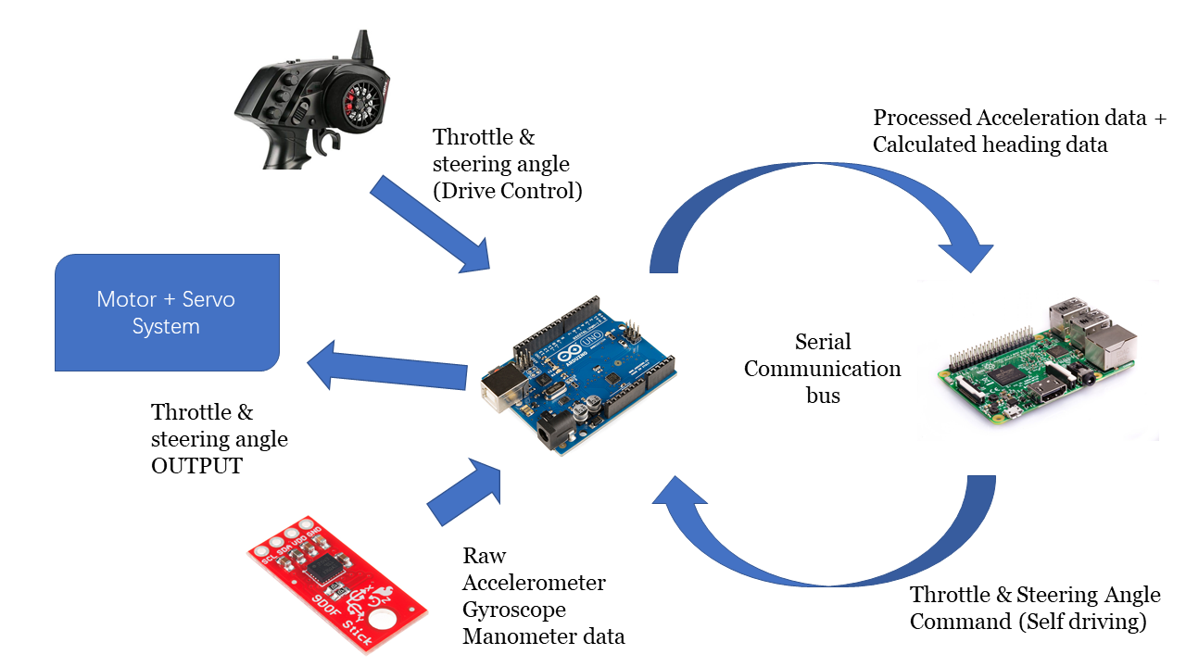
System integration
Arduino Genuino
IMU sensor
RaspberryPi
Motor + Servo
ESC
Remote control
Receiver

Slide 7
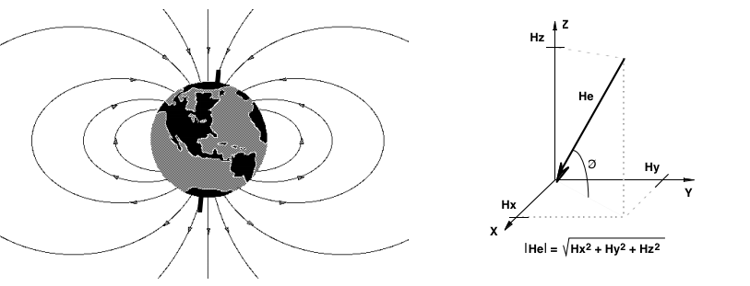
Determining current location
Calculating heading

Slide 8
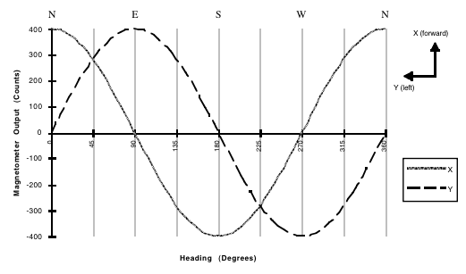
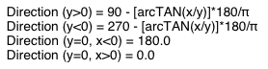
Determining heading
Theoretical magnetometer readings

Slide 9
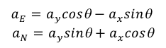
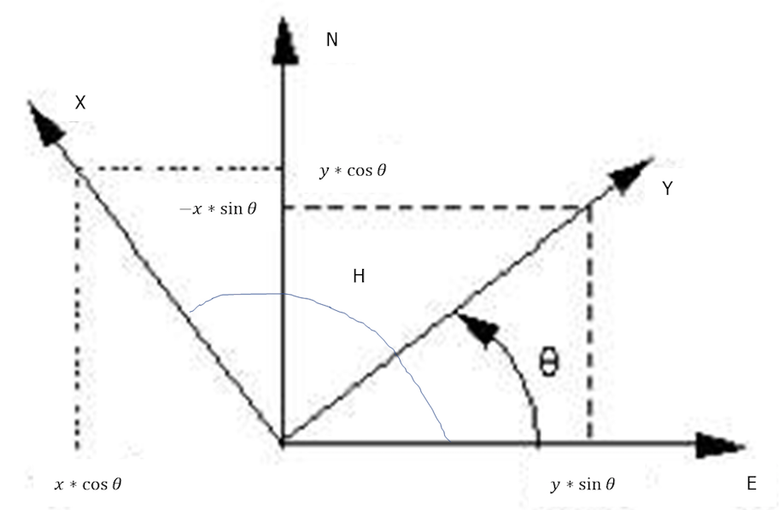
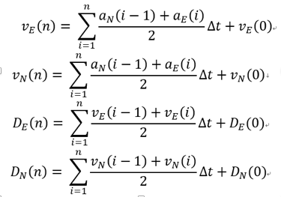
Determining current location
Rigid body transformation
From IMU coord. to Earth coord.

Slide 10
Challenges
Calibrating IMU
Manual calibration: average method, offset method
Found strong magnetic interference in the lab
Temporary solution: move experiments outdoor
Powering the PiCar system
Power distribution board
Remote control input noisy
Multiple trimming
Algorithm development: calculating current location
Occasional empty output file
Solved by automatically shutdown RaspberryPI

Slide 11
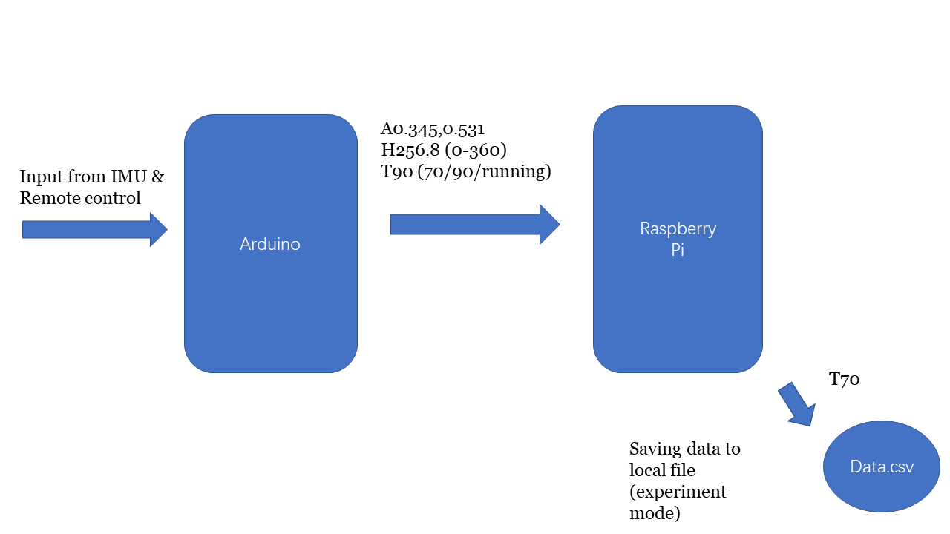
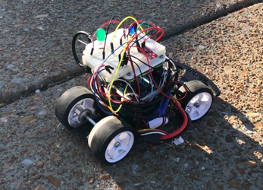
Experiment setup
Data transmission

Slide 12
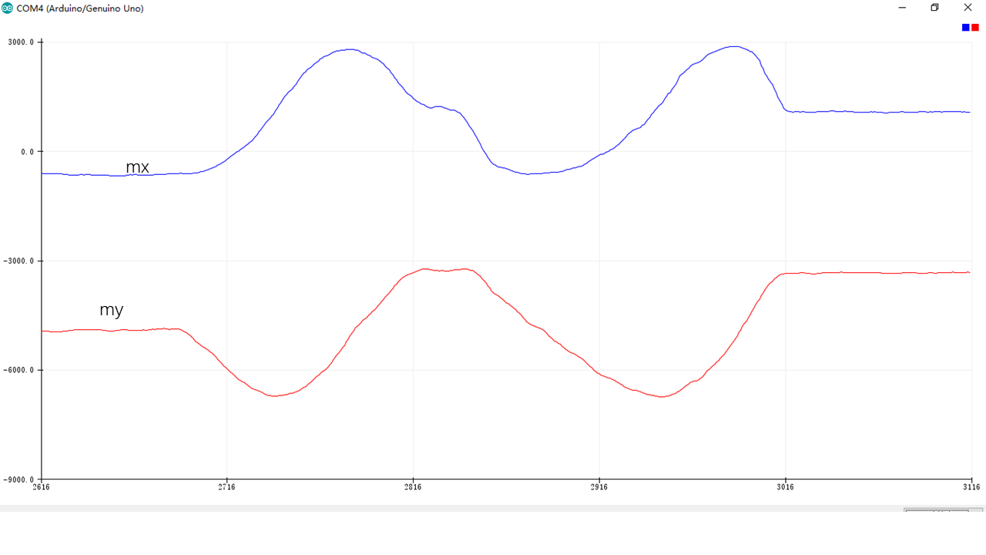
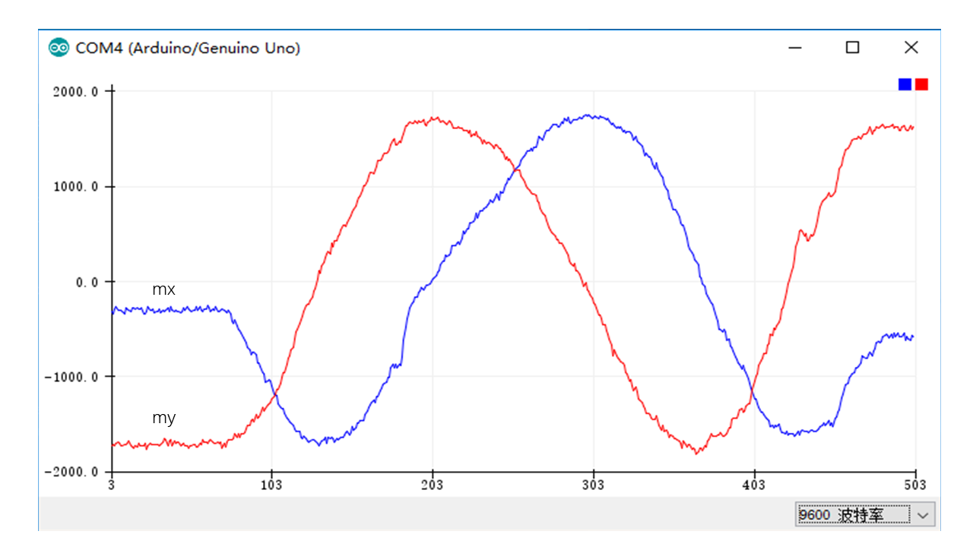
Offset magnetometer data
Magnetometer readings before (left)
& after offset (right) when the car is rotated
Data & processing

Slide 13
Magnetic interference in the lab

Slide 14
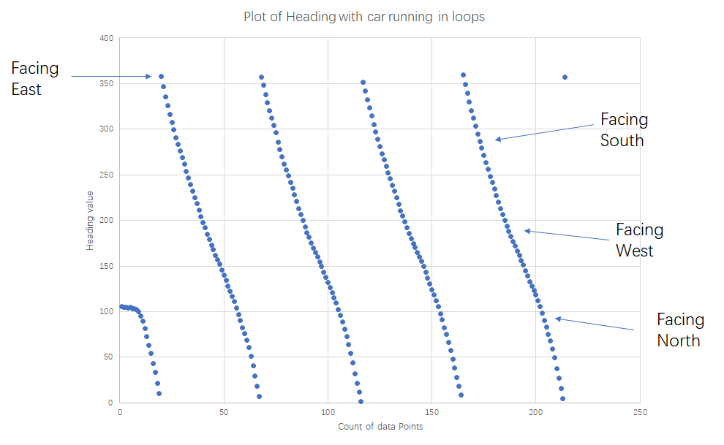
Circulated Heading (circular motion)

Slide 15
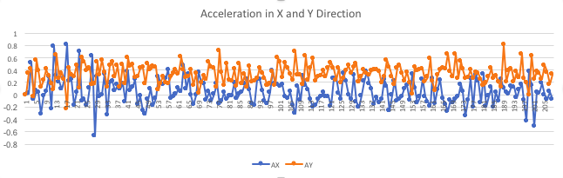
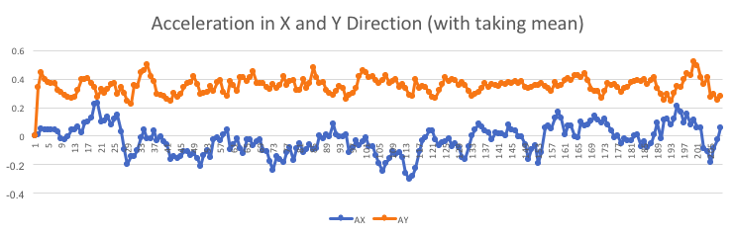
Acceleration: taking mean

Slide 16
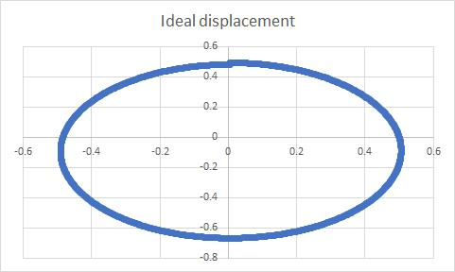
Ideal displacement of uniform motion

Slide 17
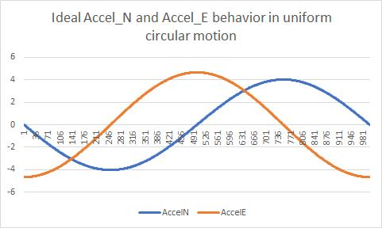
Ideal acceleration

Slide 18
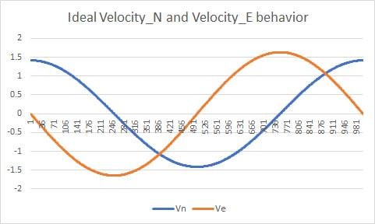
Ideal velocity

Slide 19
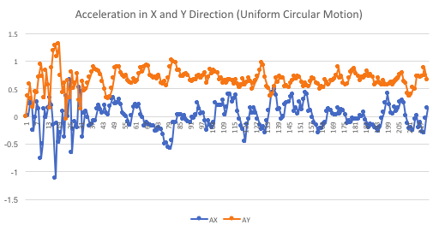
Acceleration in X & Y direction

Slide 20
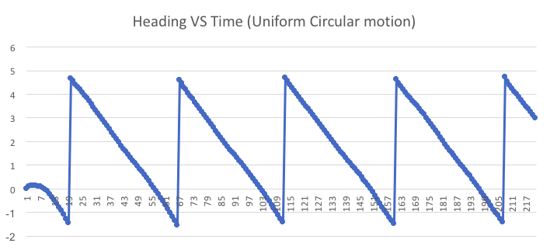
Heading data

Slide 21
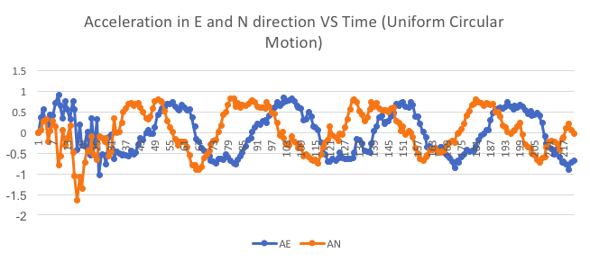
Acceleration in East & North Direction

Slide 22
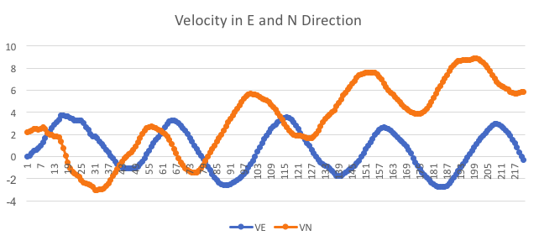
Velocity in East & North Direction

Slide 23
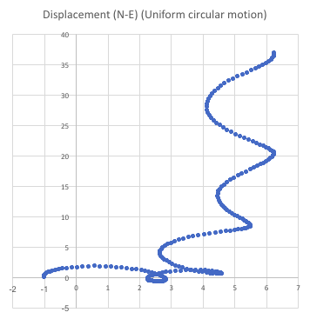
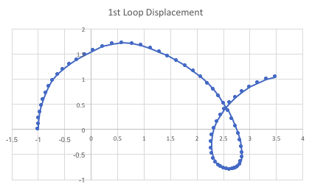
Displacement (North - EAst)

Slide 24
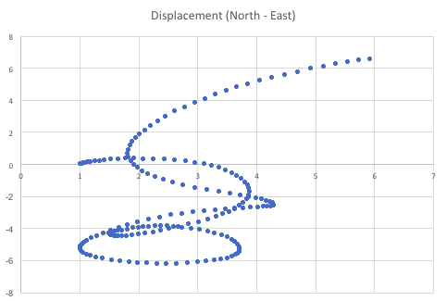
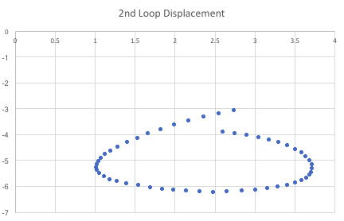
Displacement (North - EAst)

Slide 25
Future plans
Avoid magnetic interference
Find the cause of the interference & possible filtering methods
Incorporate gyroscope data to check the validity of magnetometer
Improve the mechanical structure of the car
The structure of the steering wheels are not ideal
Improve the accuracy of displacement calculation
Incorporate encoder
Apply high-pass & low-pass filters to process noisy data
Figure out the cause of the phase difference of Ae & An

